Slide 1
Understanding Web Sockets
André Masson
Octobre 2022

Slide 2
Included in this full stack project (typescript)
Backend (Node.js)
Remember each connected socket
Handling incoming messages
Broadcast (message response) to registered sockets, or
Send message(s) to specific socket(s)
Frontend (React + Material-UI)
Register a unique socket (user based)
Handle socket open / close events with reconnect mechanism
Sending and receiving messages

Slide 3
WebSockets...
modern way to have persistent browser-server connections
WebSockets don’t have cross-origin limitations
they are well-supported in browsers
especially great for services that require continuous data exchange
it’s easy to emit messages from both client and server
events are simple : open, close, error, message

Slide 4
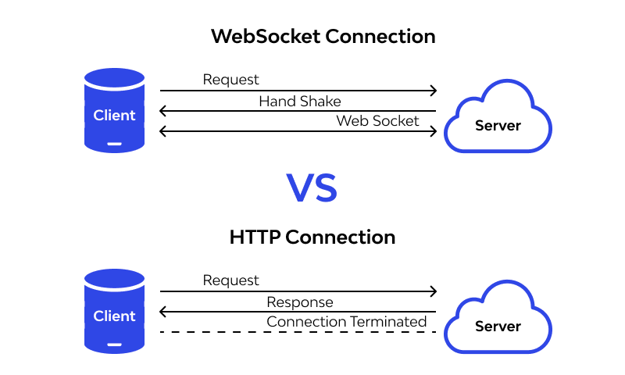
Comparing to http protocol

Slide 5
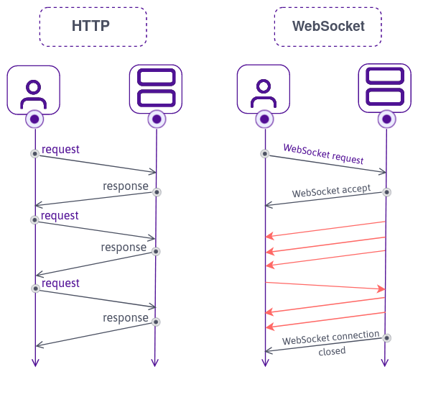
HTTP agnostic nature needs auth headers

Slide 6
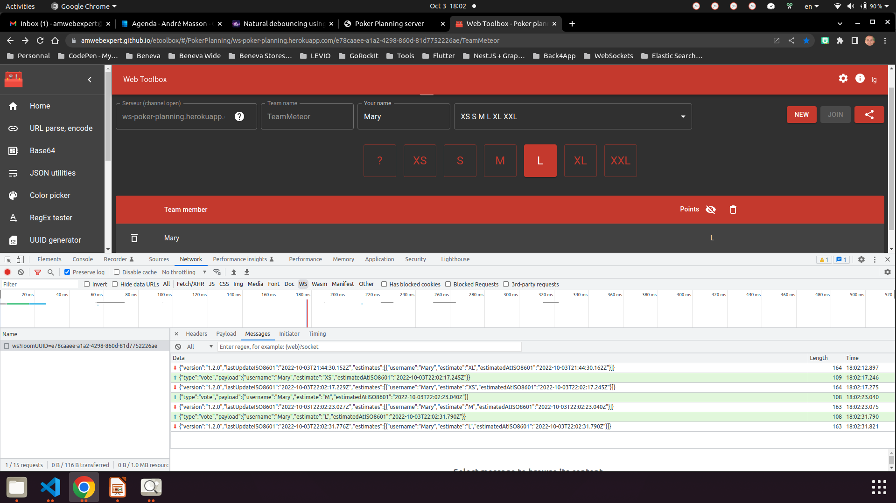
A web socket is likely to close after a delay

Slide 7
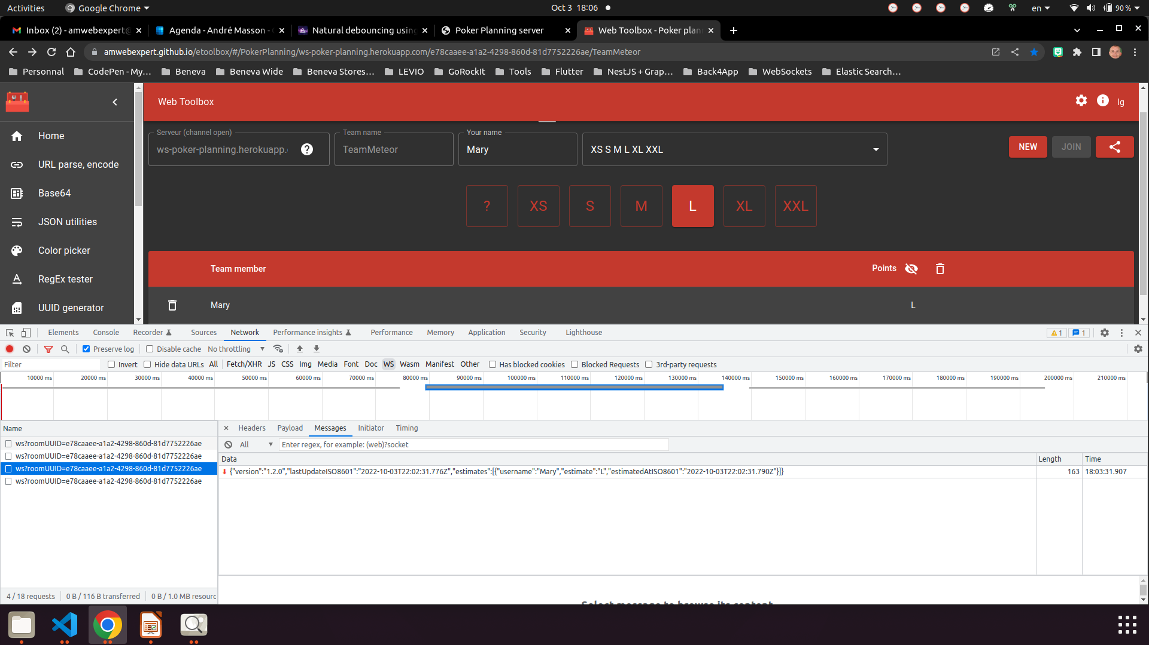
A web socket will close after a delay

Slide 8
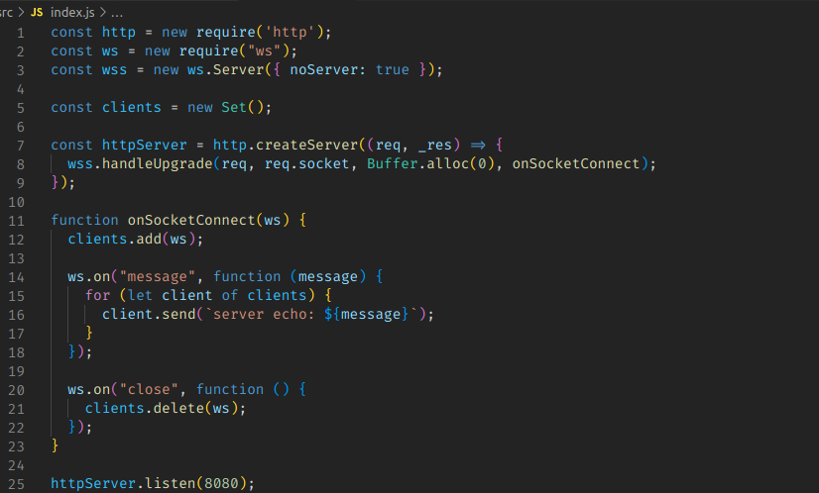
Web sockets server simple pure javascript example

Slide 9
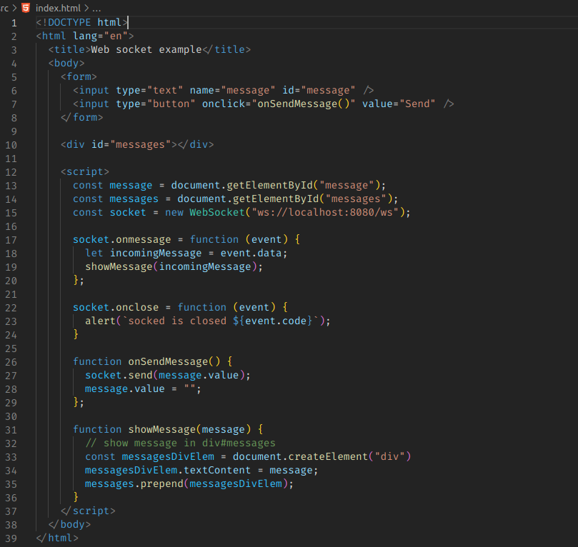
Web sockets client simple pure javascript example

Slide 10
Let’s play with the simple examples
Open 2 browsers 1 incognito
Log message received type on backend
Log close events on client and server (add event on client and just stop the server)
Simulate server droping connections
Automatic WebSockets reconnections?
https://cloud.google.com/run/docs/triggering/websockets#client-reconnects

Slide 11
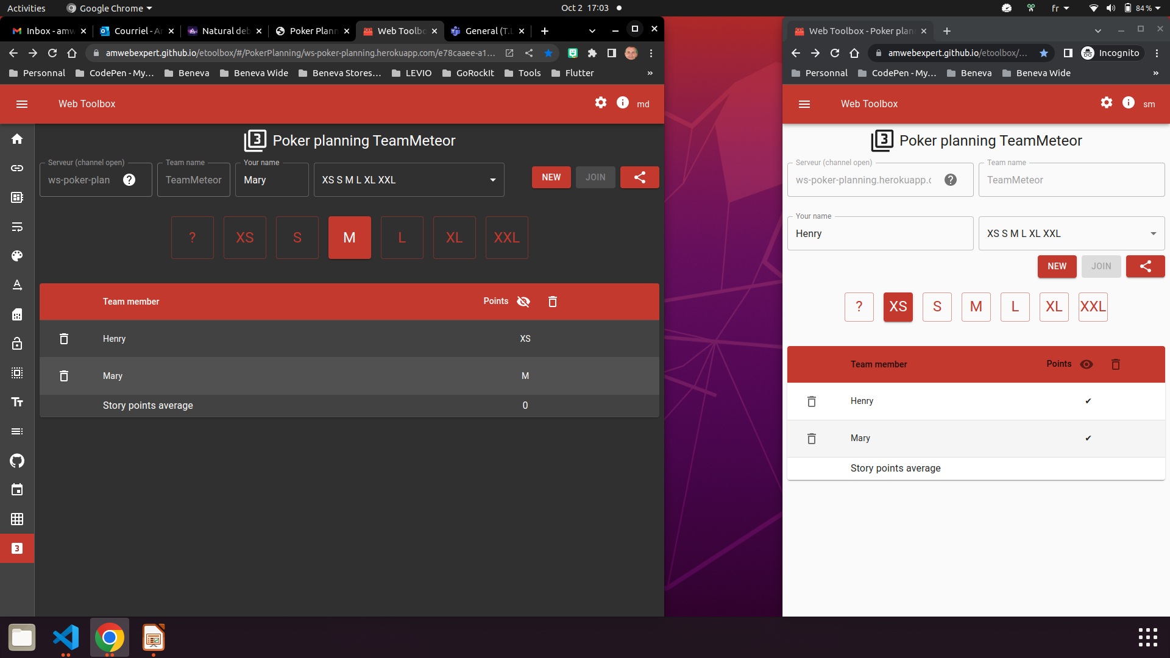

Slide 12
Other considerations
can send/receive text OR binary data (string, Blob, ArrayBuffer)
does not include reconnection, authentication and many other high-level mechanisms. So there are client/server libraries for that, and it’s also possible to implement these capabilities manually
the rate of data transmission (message chunks) can be limited and buffered
we can deal with close event well known reasons
Node.js single thread nature vs multi-threaded engines (like JVM)
InMemory vs Database and Messaging services for better scalability (load balancing)

Slide 13
References
Web socket server GitHub repository
https://github.com/amwebexpert/ws-poker-planning
Web socket client GitHub repository
https://github.com/amwebexpert/etoolbox

